Slide 1
#5E6D80
(94.109.128)
#006791
(0.103.145)
#17B3D1
(23.179.209)
#00907B
(0.144.123)
#003348
(0.51.72)
#919EAD
(145.158.173)
#008FC8
(0.142.200)
#A1C7E7
(161.199.231)
#03C1AA
(3.193.170)
#004E60
(0.78.96)

Slide 2
#A1C7E7
(161.199.231)
#008FC8
(0.142.200)
#006791
(0.103.145)
#003348
(0.51.72)
Mono Color Sample
#919EAD
(145.158.173)
#A1C7E7
(161.199.231)
#008FC8
(0.142.200)
#006791
(0.103.145)
#003348
(0.51.72)
#5E6D80
(94.109.128)
#919EAD
(145.158.173)
#A1C7E7
(161.199.231)
#17B3D1
(23.179.209)
#008FC8
(0.142.200)
#006791
(0.103.145)
#003348
(0.51.72)
#5E6D80
(94.109.128)
#919EAD
(145.158.173)
#006791
(0.103.145)
#008FC8
(0.142.200)
#17B3D1
(23.179.209)
#A1C7E7
(161.199.231)
#03C1AA
(3.193.170)
#00907B
(0.144.123)
#004E60
(0.78.96)
#003348
(0.51.72)

Slide 3
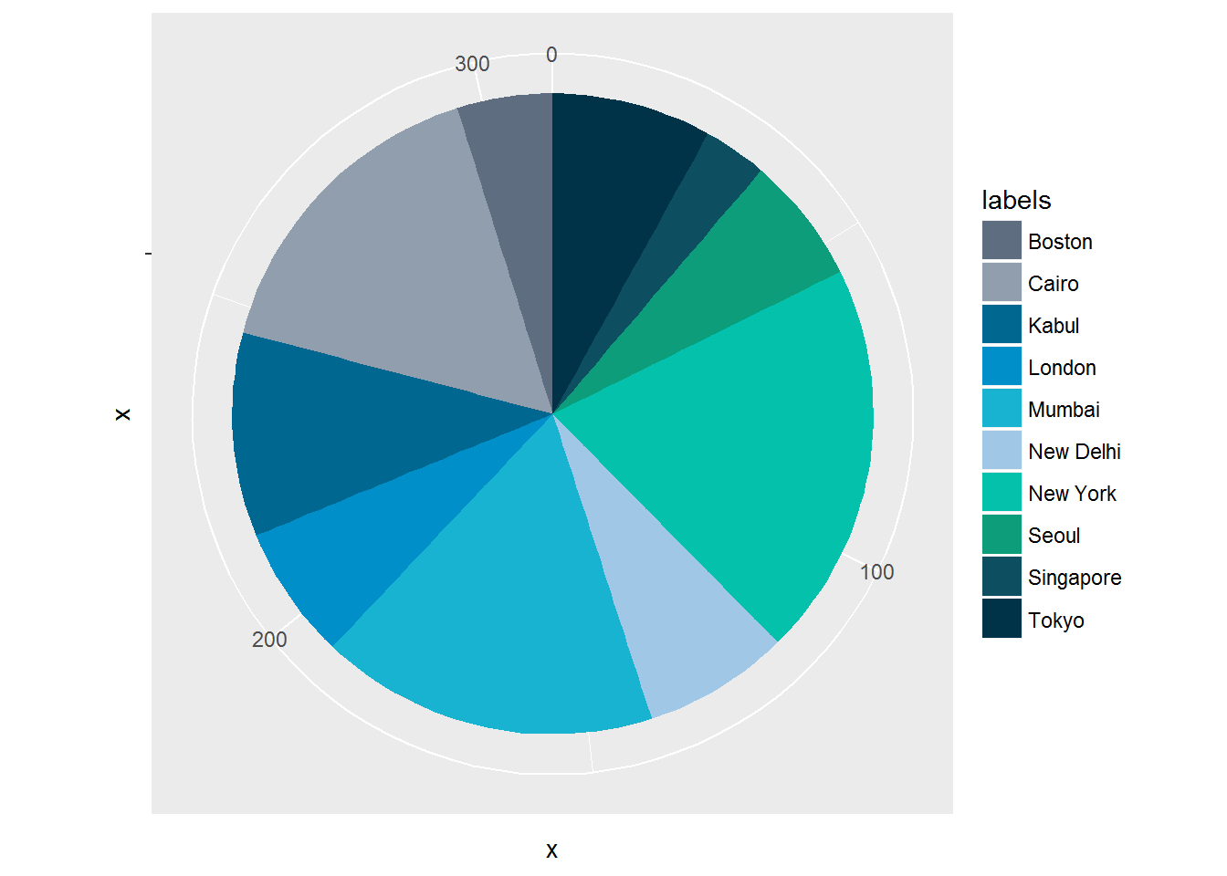
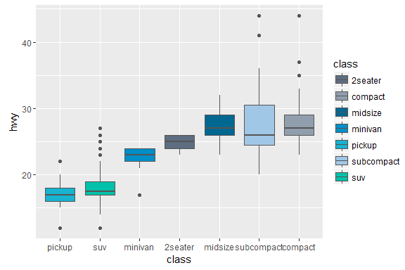
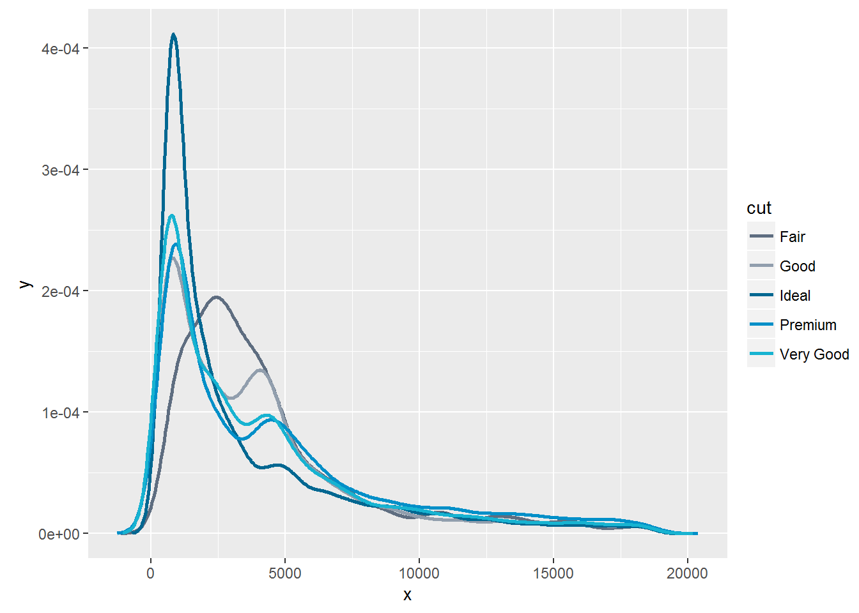
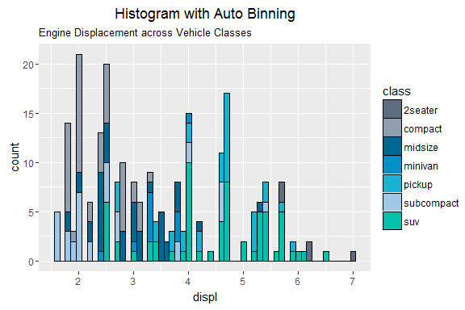
Sample:
Mono 10 Colors

Slide 4
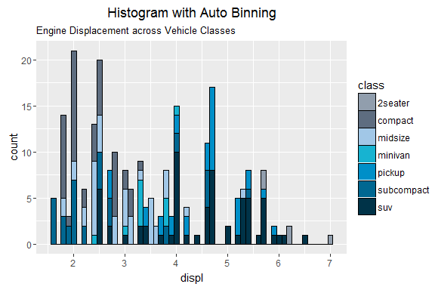
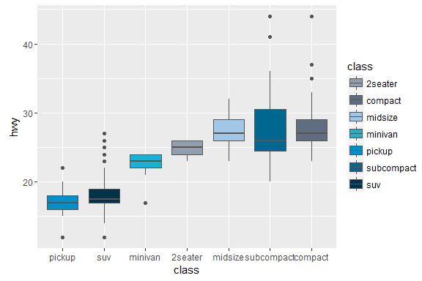
Sample:
7 Mono colors

